Slide 1
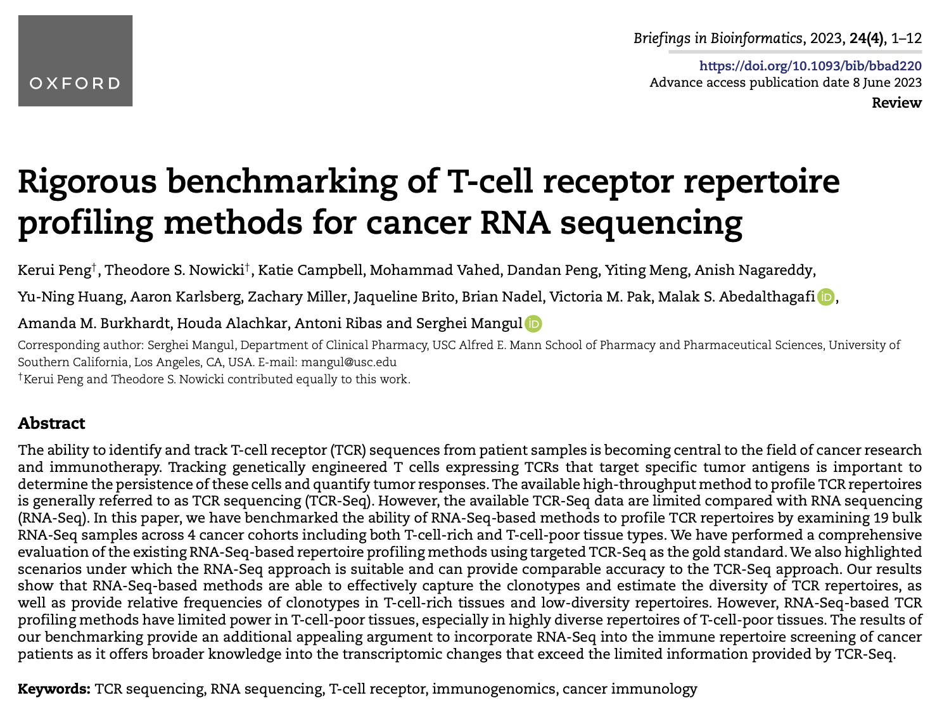
Journal club
1-9-2024
Ty Bottorff

Slide 2
Background
Available TCR-seq data is limited compared with RNA-seq data
MiXCR (RNA-seq method) has detected TCR beta sequences with relative frequencies > 0.15% in T cell rich tissue (PMC6169298)

Slide 3
Goal
Use RNA-seq-based methods (in lieu of TCR-seq-based ones) to profile TCR repertoires
for example in immune repertoire screenings of cancer patients
measuring diversity, clonality, tracking engineered T cells expressing chimeric TCRs targeting tumor antigens…
RNA-Seq-based TCR profiling methods have not been benchmarked, only validated in small numbers of samples

Slide 4
Methods
Examine 19 bulk RNA-seq samples across 4 cancer cohorts in both T-cell-rich and T-cell-poor tissues
Compare RNA-seq-based methods to targeted TCR-seq (gold standard)

Slide 5
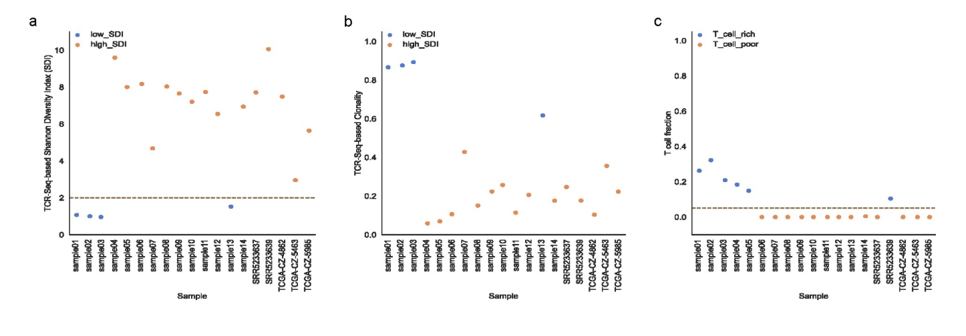
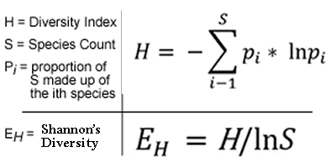
Distribution of SDIs, clonality scores, T cell fractions across samples
SDI of 2 is cutoff between
low and high groups
Notes:
Define samples with Shannon diversity index (SDI, E_{H}) < 2 as low SDI, SDI => 2 as high SDI

Slide 6
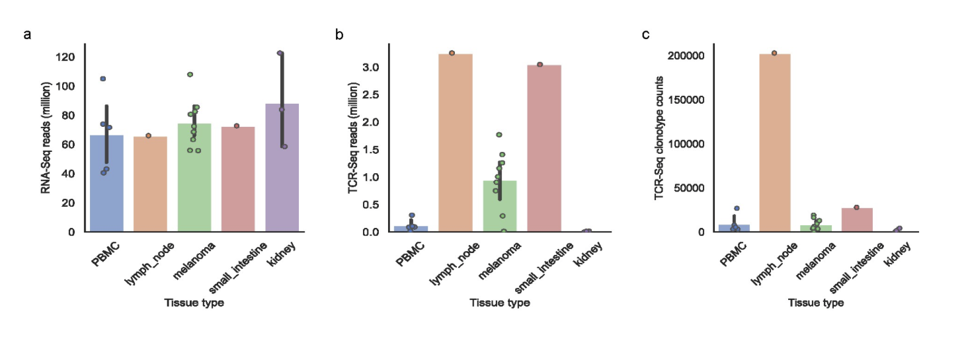
RNAseq reads are consistent across tissue types. Lymph node tissue is the most T cell rich

Slide 7
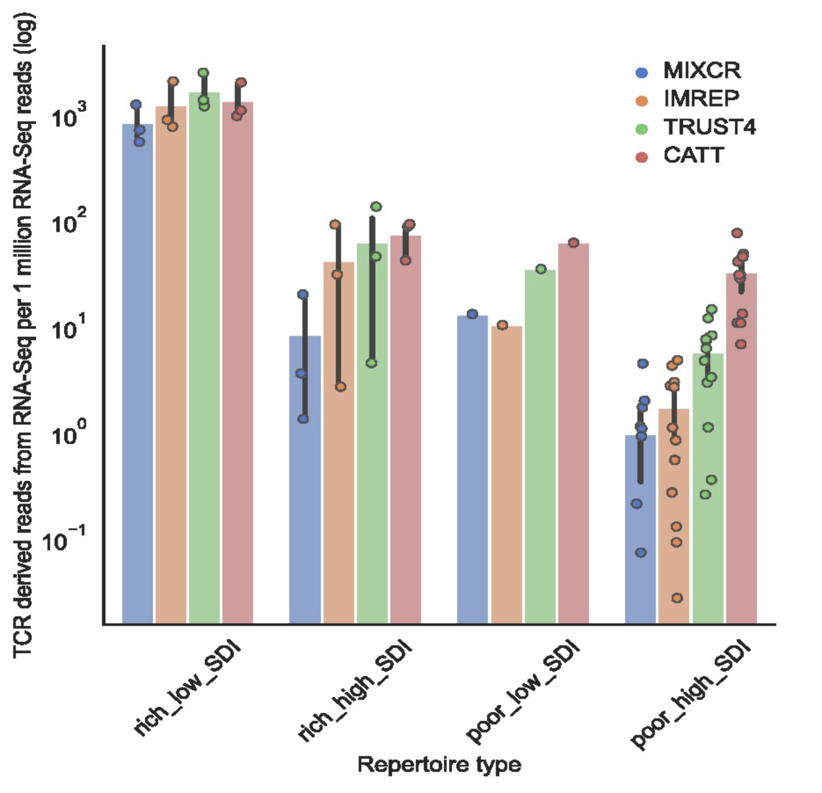
Fewer RNAseq TCR reads in T cell poor tissue vs. T cell rich tissue
Notes:
CATT and TRUST4 perform better than MiXCR in T cell poor high SDI samples

Slide 8
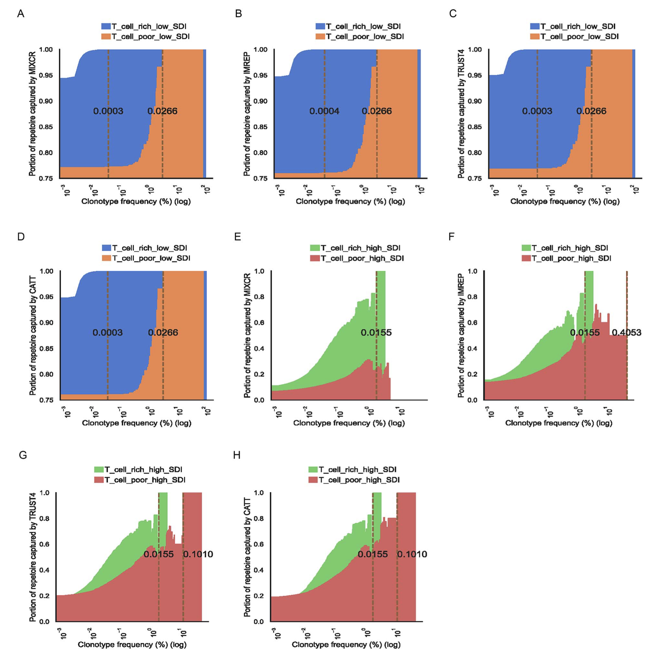
RNAseq methods capture most TCR clonotypes unless sample is T cell poor and high SDI (red)
X-axis: TCRseq confirmed clonotypes with frequency Z
Y-axis: average fraction of TCR clonotypes assembled by RNAseq methods with clonotype frequency > Z
Vertical lines: minimal clonotype frequency above which all clonotypes are captured
Notes:
Area plots show proportion of TCR clonotypes captured by method based on clonotype frequencies
i.e. better RNAseq method for non-poor/high SDI due to ability to capture all clonotypes with rarer frequencies
Capturing ability based on sum of TCRseq confirmed TCR beta clonotypes captured in RNAseq methods
Samples with no clonotype at given freq are excluded
RNAseq methods capture ~93% of clonotypes in T cell rich low SDI samples, ~76% in T cell poor low SDI samples (average capture %s)

Slide 9
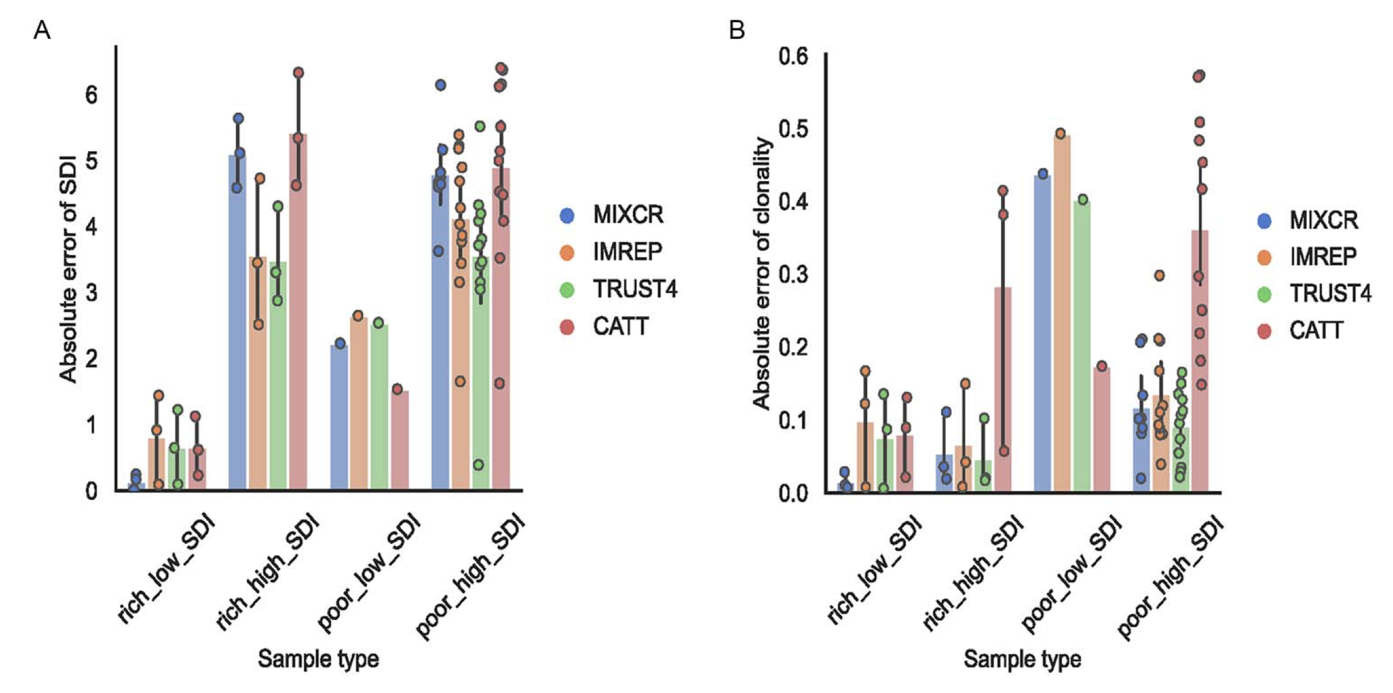
RNAseq methods able to estimate clonality in T cell rich tissues
Y-axis: error between RNAseq & TCRseq based SDI or clonality scores
Notes:
Lower error between RNAseq and TCRseq based diversity estimates in SDI low tissue
Also looked at clonality to take number of clonotypes into account (SDI doesn’t take this into account)

Slide 10
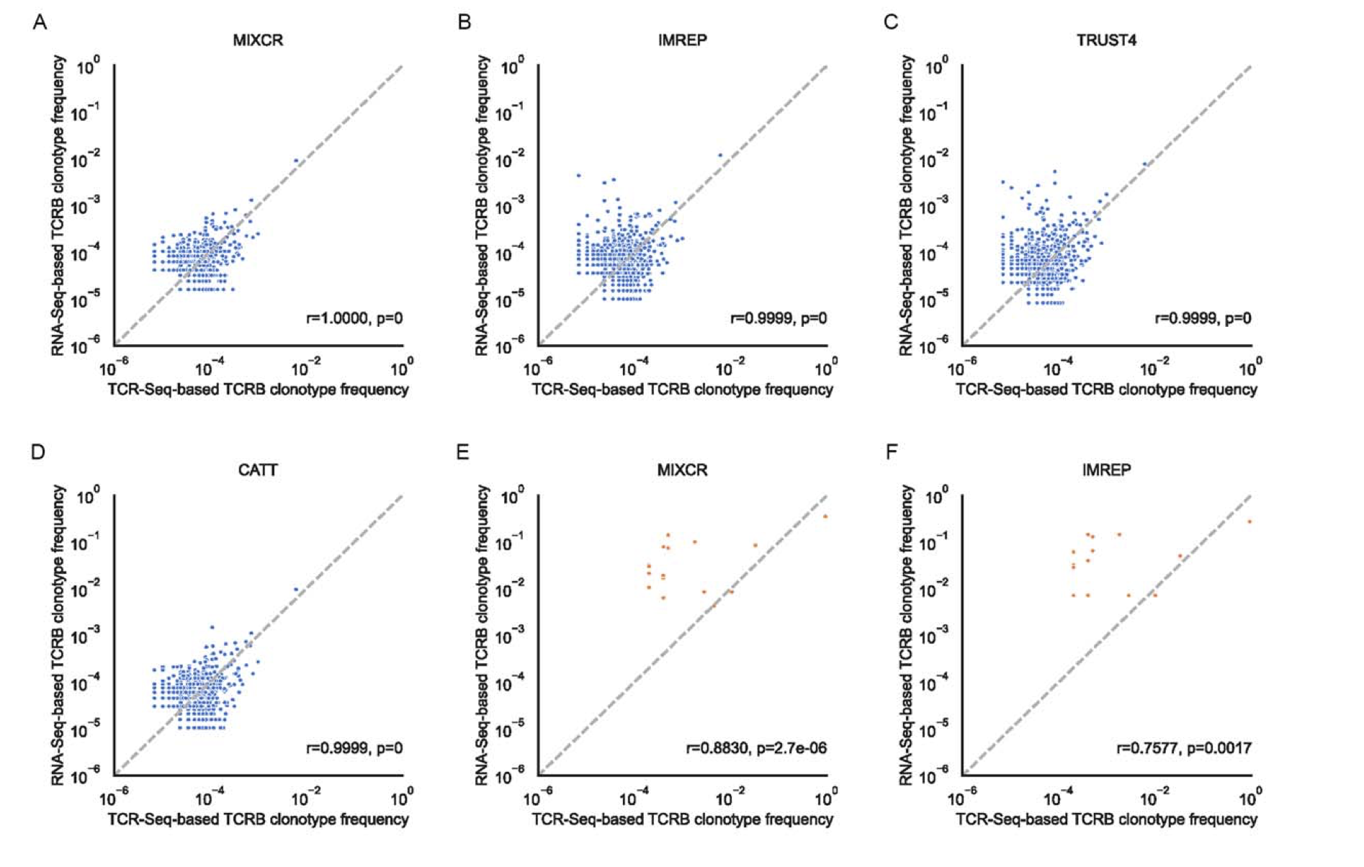
Great correlation between RNAseq & TCRseq based clonotype frequencies in T cell rich low SDI samples

Slide 11
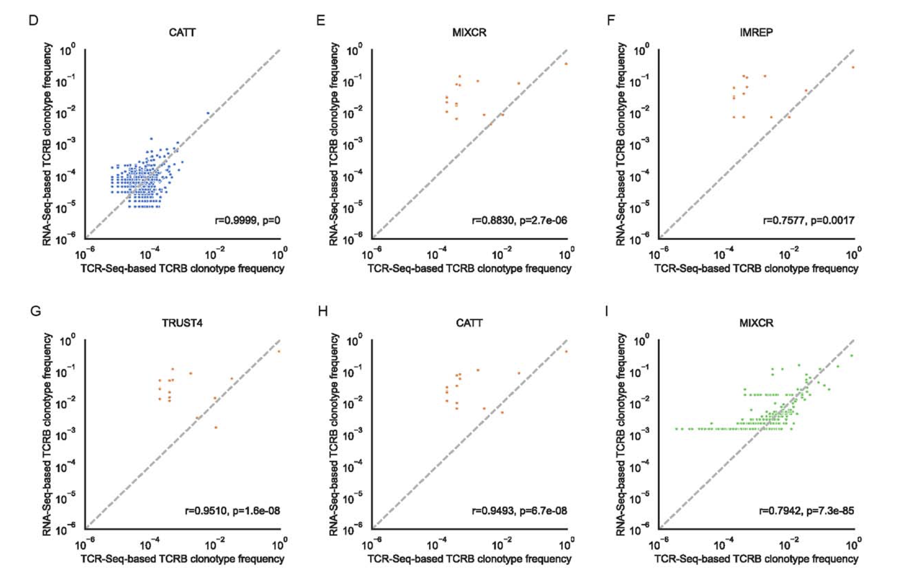
Good correlation between RNAseq & TCRseq based clonotype frequencies in T cell poor low SDI samples

Slide 12
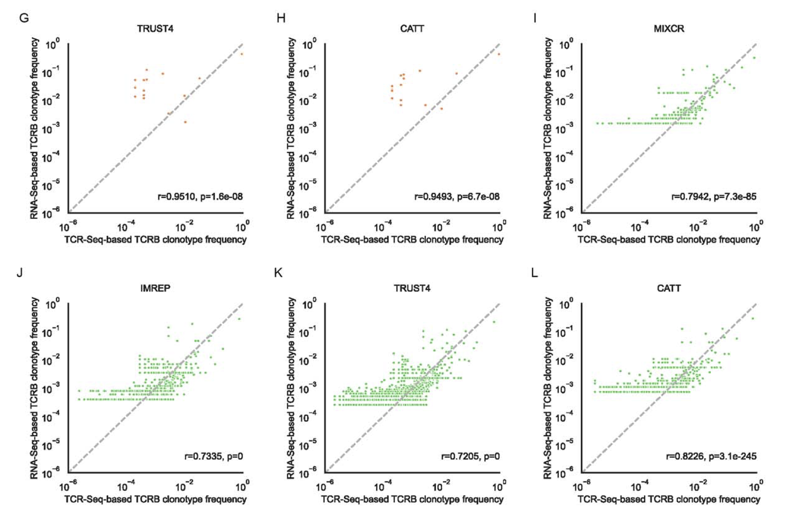
Good correlation between RNAseq & TCRseq based clonotype frequencies in T cell rich high SDI samples

Slide 13
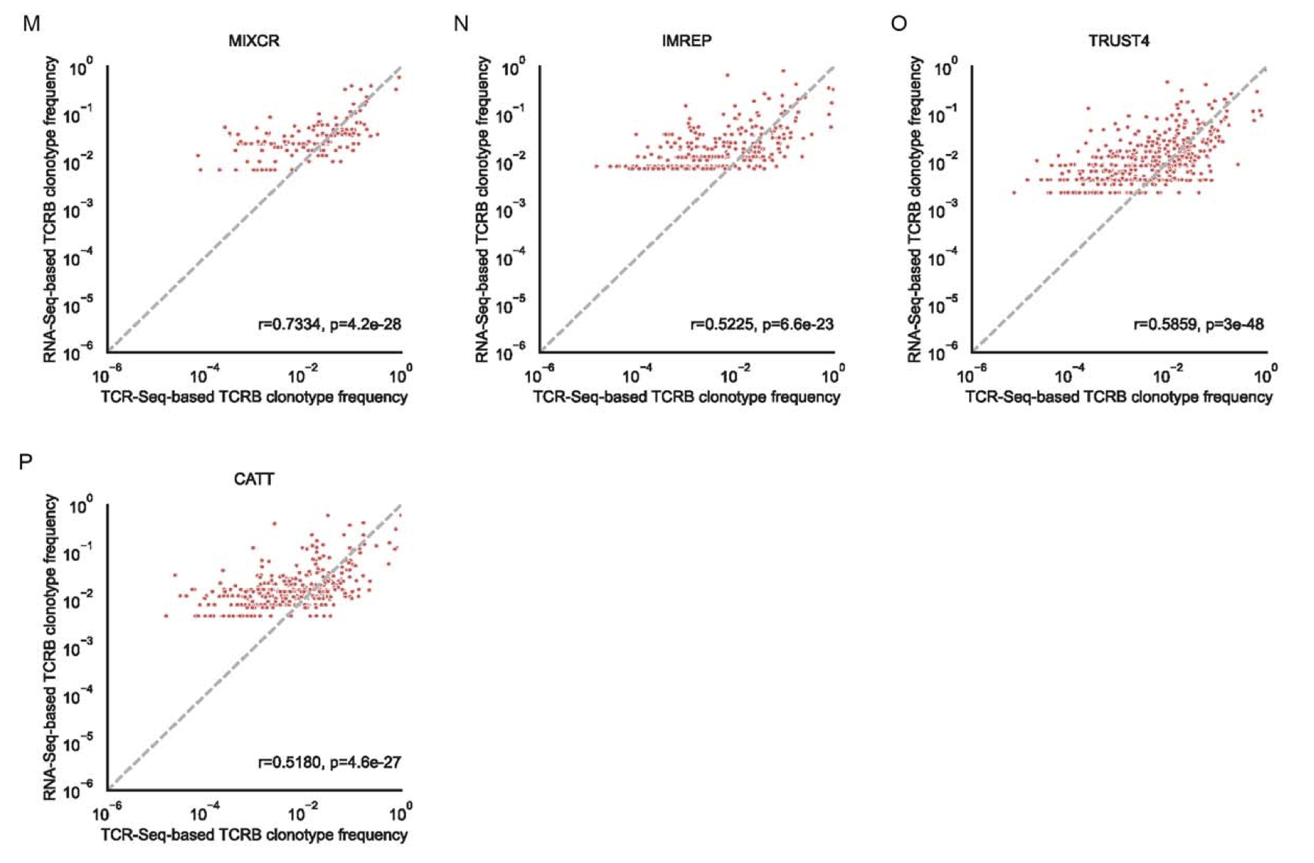
Okay correlation between RNAseq & TCRseq based clonotype frequencies in T cell poor high SDI samples

Slide 14
Conclusions
RNA-seq approach is suitable to profile TCR repertoire (capture clonotypes, estimate diversity) in T-cell-rich tissues with low diversity repertoires
T-cell-rich tissue: lymph node, small intestine?
Limited power of RNA-seq approach in T-cell-poor tissue, especially those with high T cell diversity
T-cell-poor tissue: PBMCs

Slide 15
Applications for us
Caveat: RNAseq based estimates of T cell expansion obscured by fact that RNA ~= cell abundance? i.e. using DNA there’s 1 template/cell but RNA its not always linear, expression can be higher/lower
“With gDNA as starting material, templates can be quantified, providing an absolute cell count. This makes it possible to accurately assess clonal expansion and tissue density of T cells. Complementary DNA (cDNA) or mRNA measurements are obscured by cell expression, because mRNA molecules cannot be directly correlated to cell numbers and may not provide an accurate measure of clonality.” (Adaptive)
Notes:
## Discussion
- TCRseq costs more than RNAseq?

Slide 16
Notes from comment to pub:
TRUST and ImRep don’t consider nucleotide quality, MiXCR does (can be disabled)
False positives coming from genomic regions unrelated to immune receptor genes that contain sequence patterns resembling TCR/CDR3 sequences that don’t appear in TCRseq. Instances where TCR clonotypes are identified via RNAseq but not TCRseq could be false positives from RNAseq or false negatives from TCRseq (missed clonotypes). Hard to differentiate between 2 possibilities
Singletons (clones with 1 read) were removed as likely false positives, but perhaps it’s better to just go by Phred quality score to get at errors at nt level

Slide 17
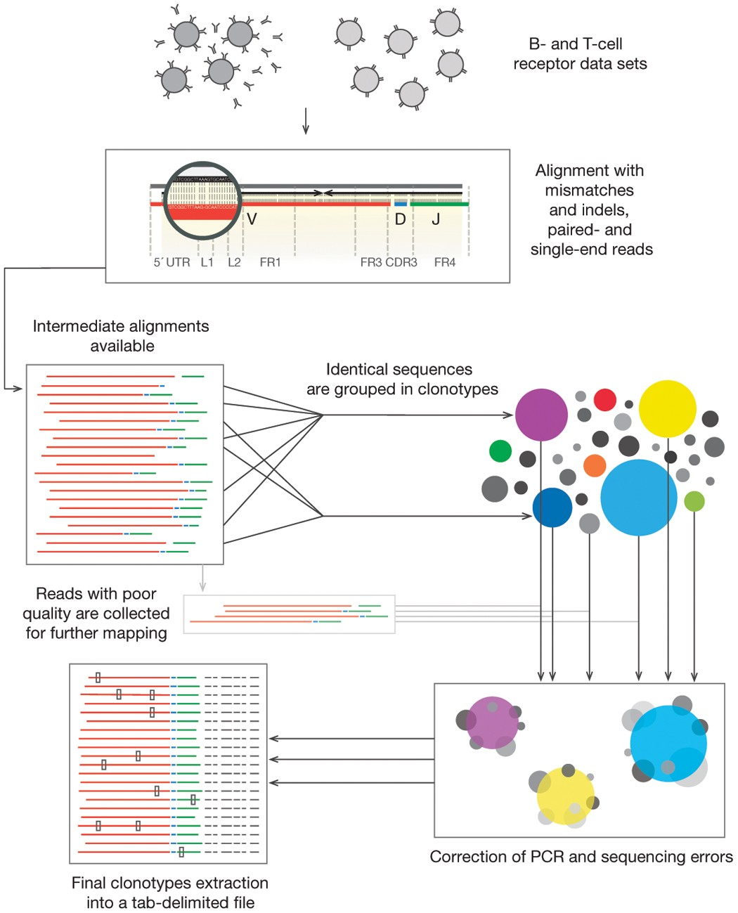
MiXCR methods
Typical MiXCR workflow consists of three main processing steps:
align: align sequencing reads to reference V, D, J and C genes of T- or B- cell receptors
assemble: assemble clonotypes using alignments obtained on previous step (in order to extract specific gene regions e.g. CDR3)
export: export alignment (exportAlignments) or clones (exportClones) to human-readable text file
Notes:
## Discussion
- TCRseq costs more than RNAseq?

Slide 18
IMREP methods
In the first stage, ImReP infers the CDR3 sequences from reads that simultaneously overlap V and J gene segments. We defined the CDR3 as the sequence of amino acids between the cysteine on the right of the junction and phenylalanine (for IGK or IGL) or tryptophan (for IGH) on the left of the junction. We first converted the read sequences from nucleotides to amino acids. We scanned the amino acid sequences of the read and determined the putative CDR3 as a sub-sequence of the read, starting from cysteine (C) and ending with phenylalanine (F) (and tryptophan [W] for IGH). The reads containing the described substring were considered candidate CDR3 reads. We denoted n to be the length of the read. We denoted the coordinates of the putative CDR3 string to be x and y, corresponding with the start and the end of the CDR3 sequence, respectively, in the read coordinates. This way each candidate CDR3 read is composed of three parts. The first part of the CDR3 read contains a prefix of the read, which potentially overlaps with the suffix of V gene. The prefix contains the amino acids from the read, from position 0 to x − 1. The second part of the CDR3 read is a substring of the read containing the putative CDR3 sequence. It contains the amino acids from the read, from position x to y. The third part of the CDR3 is a suffix of the read that potentially overlaps with the prefix of J gene. The suffix contains the amino acids of the read, from position y + 1 to n.
The amino acid sequences of the V and J genes of BCRs were imported from IMGT information system (http://www.imgt.org/vquest/refseqh.html#V-D-J-C-sets). For each V gene, we identified the last conserved cysteine (C) and recorded the position p_{C} of the read. For each J gene, we identified the first conserved phenylalanine (for IGK or IGL) or tryptophan (for IGH) and recorded its position p_{F}. (We identified the position of phenylalanine or tryptophan in the J gene sequence. Such positions are referred to as p_{F}.) For each V gene, we extracted two substrings:
(1)
For each J gene, we recorded two substrings:
(2)
Here, n_{V} and n_{J} are the lengths of V and J genes, respectively. Given a set of candidate CDR3 reads, we attempted to find the corresponding V and J genes. We matched a substring of the read r[0, x − 1] with the corresponding suffix of V_{x} for V genes. We also matched the read r[y + 1, n] with the corresponding prefix of J_{x} for J genes. We considered a read to match the V gene if the length of r[0, x − 1] is greater than four and the edit distance between r[0, x − 1] and V_{x} is <2. We considered a read to match the J gene if the length of r[y + 1, n] is >4, and the edit distance between r[y + 1, n] and J_{x} is <2. In cases where a read overlaps equally (in terms of edit distance) among multiple V genes and J genes, all matching V genes are reported.
In the second stage, ImReP utilizes the reads overlapping only with the V or J gene. Such reads contain a partial CDR3 sequence. ImReP builds a suffix tree S on the reads overlapping any of the V genes. Then, for each read j overlapping a J gene a V-gene overlapping read, v from S is determined (in cases where any exists). Reads v and j are concatenated (based on the overlap) and the CDR3 region is extracted.
Further, ImReP uses a CAST clustering technique to correctly assemble CDR3s for PCR and sequencing errors. The output of the algorithm is the set of CDR3 partitions, and each of the partitions corresponds to a clonotype. Specifically, ImReP builds a complete graph G = (V, E, w), where the set of vertices V is represented by the set of assembled CDR3 sequences. The weight of the edge is determined by the inverse of the edit distance, computed between the two CDR3 sequences x and y. The CAST algorithm is executed with the following procedure. A new partition P is initialized with the max-degree node. Then, the set of “close” vertices is iteratively added to the partition, and the set of “distant” vertices are removed from the partition. A vertex v is deemed to be “close” (“distant”), if the average distance from v to the vertices from P is greater (smaller) than a user-defined threshold. The procedure is repeated until either the set of “close” or the set of “distant” vertices is empty. In such a way, the partition P is based on a max-degree node and extended with the “close” vertices. Vertices belonging to P are then removed from the graph G and the clustering procedure is repeated until all of the vertices are assigned to a partition. Let {v₁, v₂,…,v_{i},…,v_{n}} be a partition output by the CAST algorithm. Each v_{i} has an associated weight equal to the count of CDR3’s v_{i}, which was assembled during the first two stages of ImReP. We computed the weighted consensus sequence of P and output the sequence as a final clonotype. Finally, we mapped D genes (for IGH) onto assembled CDR3 sequences and infer corresponding V(D)J recombination. Starting with release v0.8, ImReP reports the out-of-frame CDR3 sequences.
ImReP is a method to quantify individual immune response based on a recombination landscape of genes encoding B and T cell receptors (BCR and TCR). ImReP is able to efficiently extract TCR and BCR reads from the RNA-Seq data and assemble clonotypes (defined as clones with identical CDR3 amino acid sequences) and detect corresponding V(D)J recombinations. Using CAST clustering technique, ImReP is able to correct assembled clonotypes for PCR and sequencing errors.
Notes:
## Discussion
- TCRseq costs more than RNAseq?

Slide 19
TRUST4 methods
TRUST4 is a computational tool to analyze TCR and BCR sequences using unselected RNA sequencing data, profiled from fluid and solid tissues, including tumors. TRUST4 performs de novo assembly on V, J, C genes including the hypervariable complementarity-determining region 3 (CDR3) and reports consensus contigs of BCR/TCR sequences. TRUST4 then realigns the contigs to IMGT reference gene sequences to identify the corresponding gene and CDR3 details. TRUST4 supports both single-end and paired-end bulk or single-cell sequencing data with any read length.
The primary input to TRUST4 is the alignment of RNA-seq reads in BAM format(-b), the file containing the genomic sequence and coordinate of V,J,C genes(-f), and the reference database sequence containing annotation information, such as IMGT (--ref).
An alternative input to TRUST4 is the raw RNA-seq files in fasta/fastq format (-1/-2 for paired; -u for single-end). You still need the files like -f, --ref from above. In this case, you can directly use IMGT's seuqence file for -f.
Notes:
## Discussion
- TCRseq costs more than RNAseq?

Slide 20
CATT methods
CATT(CharActerzing TCR repertoires) is an ultra-sensitive and accurate tool for characterizing T cell receptor sequence in bulk and single cell TCR-Seq and RNA-Seq data.
CATT employs a completely data-driven algorithm that is self-adaptive to input data without requiring additional parameters. This enables CATT to efficiently and accurately extract T cell CDR3 sequences from most types of TCR-containing raw sequencing data, including extremely short reads.
Notes:
## Discussion
- TCRseq costs more than RNAseq?

Slide 21
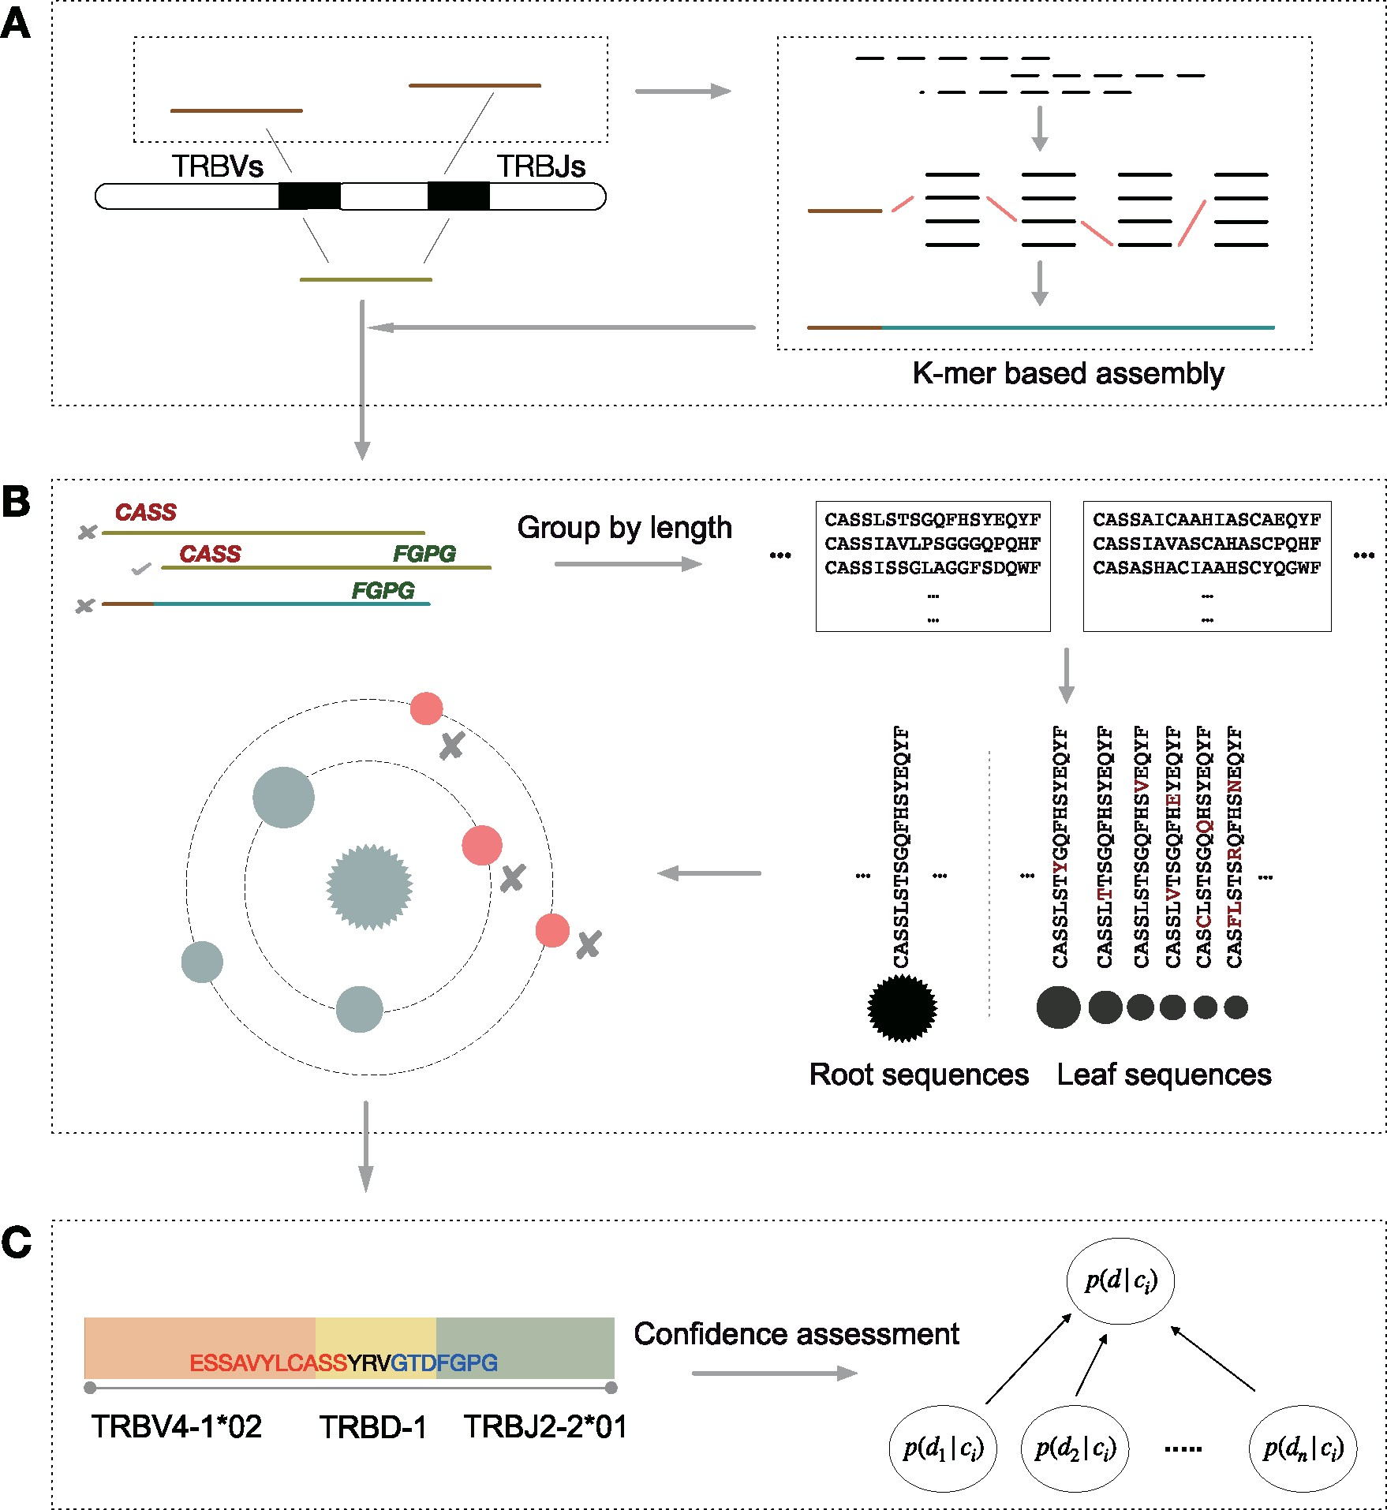

CATT methods continued
Notes:
Fig. 1. An overview of the core algorithm of CATT. (A) Candidate CDR3 detection. All reads were aligned to V and J reference genes to screen candidate (brown) reads for micro-assembly. Potential CDR3 sequences were reconstructed by de Bruijn graph-based greedy algorithm. (B) Error correction. The motif criteria from IMGT project were used to identify putative CDR3 sequences in directly found and assembled CDR3 sequences. CATT eliminates the erroneous CDR3 sequences using a data-driven transition-probability learning algorithms, which retrieves the probability of erroneous CDR3s from the observed CDR3 distribution and merges erroneous sequences (red) according to transition rates based on frequency and Hamming distance between the root and leaf sequences in the same subgroup. (C) Annotation and confidence assessment. After error correction, CATT uses a Bayes classification algorithm to assess the reliability of CDR3 sequences (differ from other protein-coding genes)
Briefly, CATT detects CDR3 sequences using reads aligned to the loci of known TCRs and de novo reassembling these reads using a greedy feasible flow algorithm. Reads both mapped to the V and J genes from IMGT (Lefranc et al., 2015) were considered as candidate CDR3-containing sequences; whereas reads partially mapped to the V or J genes were used for assembly. After assembling, CATT used the motif pattern of known CDR3s from the IMGT resource to measure whether the candidate and assembled CDR3 sequences were putative CDR3s. Next, CATT merged ultra-low-frequency putative CDR3 sequences with the high-frequency ones using a data-driven model. Finally, CATT assessed the confidence of putative CDR3 sequences using a supervised Bayesian classification method. An overview of CATT is shown in Figure 1 and the details of the algorithm and procedures are described below.
Unless provided in the caption above, the following copyright applies to the content of this slide: © The Author(s) 2020. Published by Oxford University Press. All rights reserved. For permissions, please e-mail: journals.permissions@oup.comThis article is published and distributed under the terms of the Oxford University Press, Standard Journals Publication Model (https://academic.oup.com/journals/pages/open_access/funder_policies/chorus/standard_publication_model)

Slide 22
RNAseq methods
Notes:
## Discussion
- TCRseq costs more than RNAseq?

Slide 23
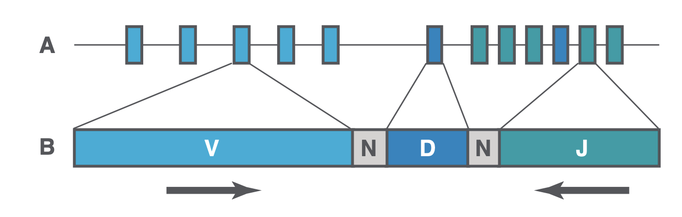
TCRseq methods
Mutliplex PCR (F primers in each V segment, R primers in each J segment), pic from Adaptive
My impression is that TCRseq ~= RNAseq except it may be from DNA and it’s more focused in its primers for just immune receptors
DNA-based methods are thought to be better suited for quantification of individual TCR clones, with a single template per cell, but this can become expensive. RNA-based methods are more sensitive and provide quantitative estimates of TCR abundance and gene expression, as well as the ability to easily incorporate unique molecular identifiers (UMIs), reducing PCR bias and enhancing accurate identification of variants and rare mutations.
multiplex PCR (mPCR) and Rapid Amplification of cDNA Ends PCR (5′ RACE-PCR) are the two most commonly used approaches. mPCR utilizes a pool of primers that targets all V and J germline genes (C genes) to amplify entire V(D)J rearrangements or specifically the CDR3 regions, but may be affected by amplification biases and produce skewed relative abundances of products. On the other hand, RNA-specific 5′ RACE-PCR utilizes a single primer set that targets the known C-gene region of mRNA transcripts.
Paper methods: Second, the TCR-Seq sequencing protocols that were used were not consistent across different study cohorts. The lymph node and small intestine samples were sequenced by rapid amplification of 5′ complementary ends (5′RACE) approach, while all other samples were sequenced by immunoSEQ (Adaptive Biotechnology, Seattle, WA).
Notes:
## Discussion
- TCRseq costs more than RNAseq?

